Slide 1
Unit 4-4 PROVING TRIANGLES CONGRUENT: HL CONGRUENCE
PLANE Geometry

Slide 2
Right Triangles:
Hypotenuse
Leg
Leg

Slide 3
Hypotenuse-Leg (HL) Congruence:
If the Hypotenuse and a Leg of One Right Triangle are Congruent to the Hypotenuse and Corresponding Leg of Another Right Triangle, Then the Triangles are Congruent.
$If in a Right Triangle \overline{AB}≅\overline{XY} and \overline{BC}≅\overline{YZ} , then ∆ABC≅∆XYZ$.
$$B$$
$$Y$$
$$A$$
$$C$$
$$Z$$
$$X$$

Slide 4
HL Theorem, you must show the following:
There are 2 Right Triangles
The Triangles Have $≅$ Hypotnuses
There is One Pair of Congruent Legs

Slide 5
Example 1:
What Information is Missing to Prove the Triangles are Congruent using the HL Postulate.
$$B$$
$$Y$$
$$A$$
$$C$$
$$Z$$
$$X$$

Slide 6
Example 2:
What Information is Missing to Prove the Triangles are Congruent using the HL Postulate.
$$Y$$
$$B$$
$$Y$$
$$B$$
$$Z$$
$$Z$$
$$X$$
$$A$$
$$X$$
$$A$$
$$C$$
$$C$$

Slide 7
Example 3:
Write a Two-Column Proof.
Given: $\overline{CD}≅\overline{EA}, \overline{AD} is the Perpendicular Bisector of \overline{CE}$
Prove: $∆CBD≅∆EBA$
$$C$$
STATEMENTS | REASONS
$$A$$
$$B$$
$$D$$
$$E$$

Slide 8
Example 4:
Write a Two-Column Proof.
Given: $\overline{AB}≅\overline{CD}, ∠B and ∠D are Right Angles$
Prove: $∆ABC≅∆CDA$
$$A$$
$$D$$
STATEMENTS | REASONS
$$B$$
$$C$$

Slide 9
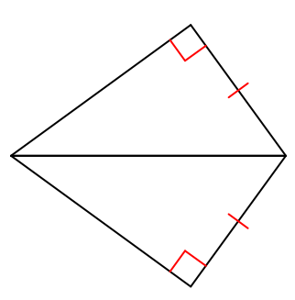
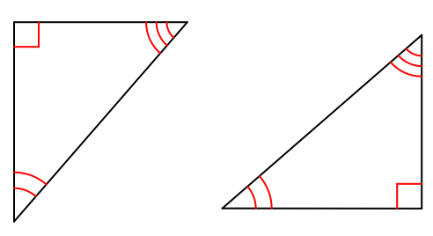
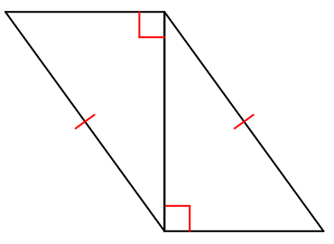
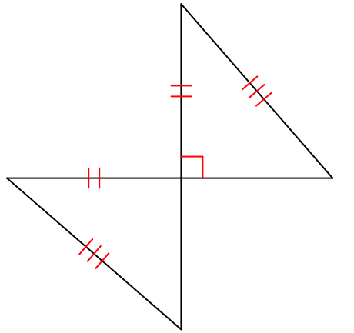
Example 5:
Are the Given Triangles Congruent by HL Theorem or Not Possible?

